Slide 1
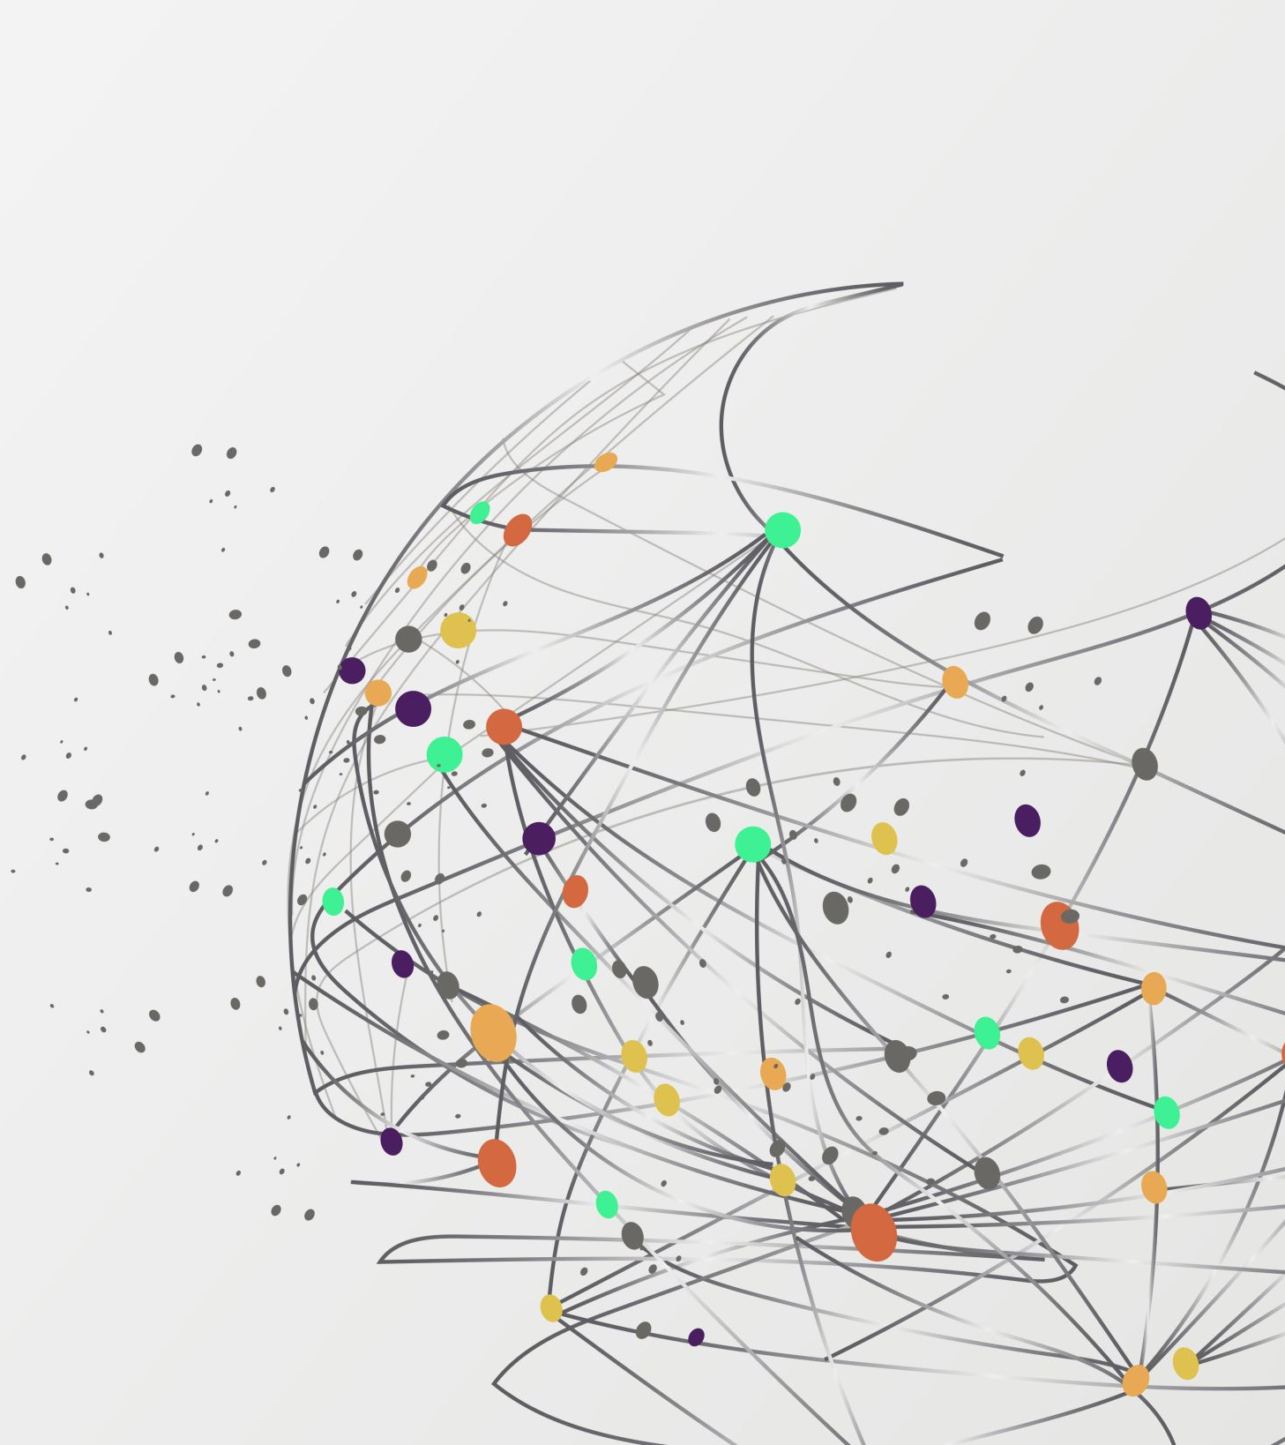


Spotify Artist Feature Collaboration Network
A COMPREHENSIVE ANALYSIS
Daniele Borghesi

Slide 2
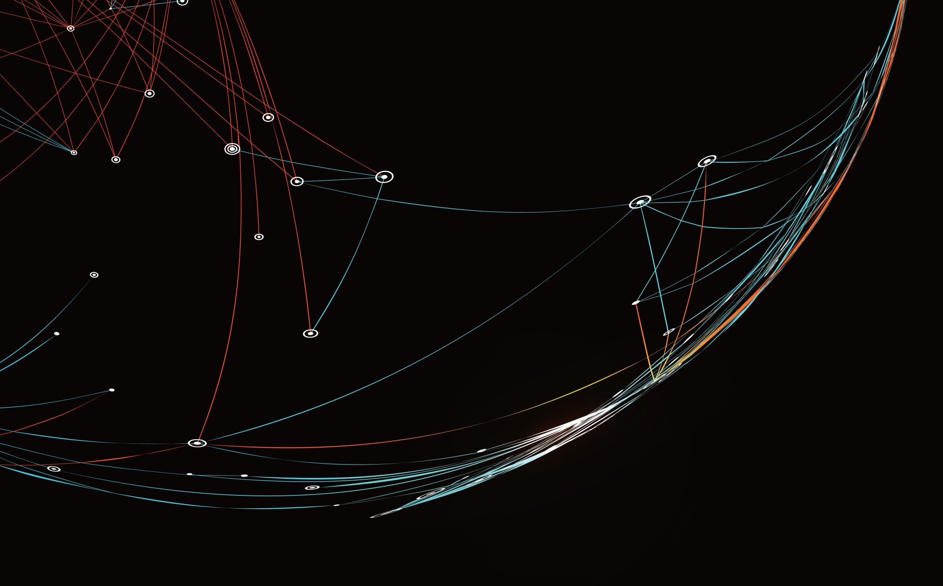

Introduction
WHAT IS THE SPOTIFY ARTIST
FEATURE COLLABORATION NETWORK?

Slide 3
What is the Spotify artist feature collaboration network?
Data on approximately 150,000 artists
Over 300,000 collaboration edges, illustrating the interconnectedness of artists in the music industry
Enables in-depth analysis of artist collaborations and network dynamics within the music industry

Slide 4

Data preparation
THE PROBLEM OF NETWORK SIZE

Slide 5
The problem of network size
With almost 150,000 nodes and over 300,000 edges, performing the analysis on the original network is extremely slow and difficult on a common hardware
Obtaining usable representations of the network can also be extremely challenging
To solve the problem, we need to simplify the network reducin its size

Slide 6
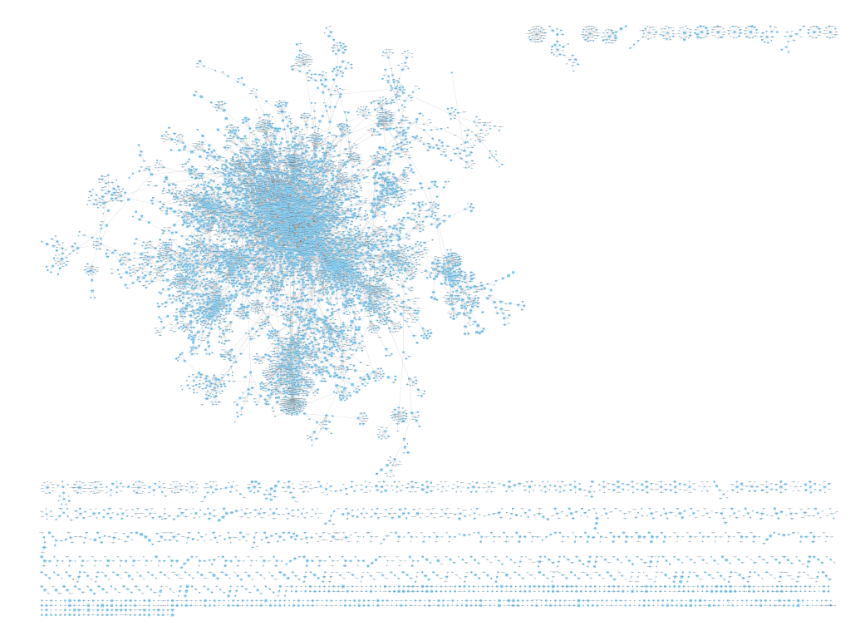
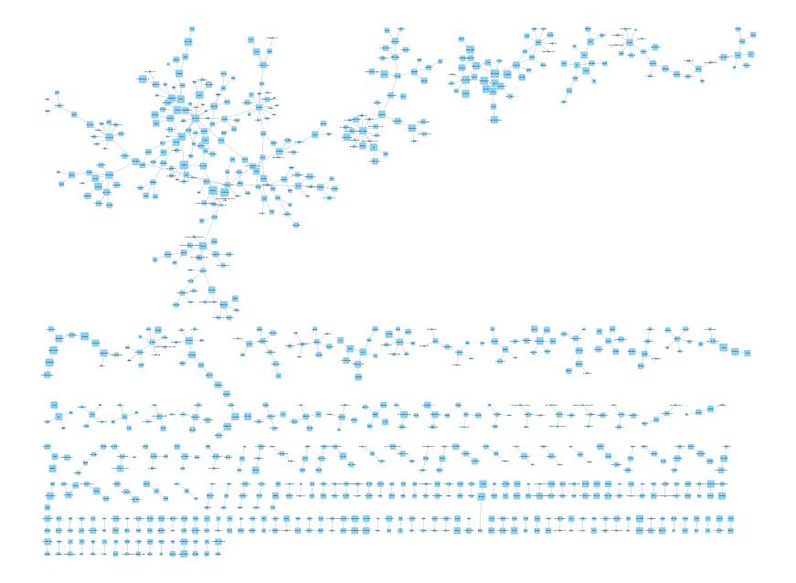
Sampling the network
Sample 1 (project part 1)
About 10,000 nodes and 12,000 edges. Used for preliminary analyses.
Sample 2 (project part 2)
About 900 nodes and 700 edges. Used for communities analysis and fault tolerance

Slide 7




Most central nodes (artists)
 | Degree Centrality | Closeness Centrality | Betweenness Centrality | PageRank | Hubs | Authorities | Eigenvector Centrality
Mc Gw | 0.0186 | - | - | 0.0056 | 0.037 | 0.037 | 0.5929
Diplo | 0.0108 | 0.2278 | 0.2075 | 0.0028 | - | - | -
Snoop Dogg | 0.0091 | 0.2164 | 0.1218 | 0.0026 | - | - | -
Jean Sibelius | 0.0125 | - | - | 0.0057 | - | - | -
Anitta | - | 0.2156 | 0.0702 | - | - | - | -

Slide 8
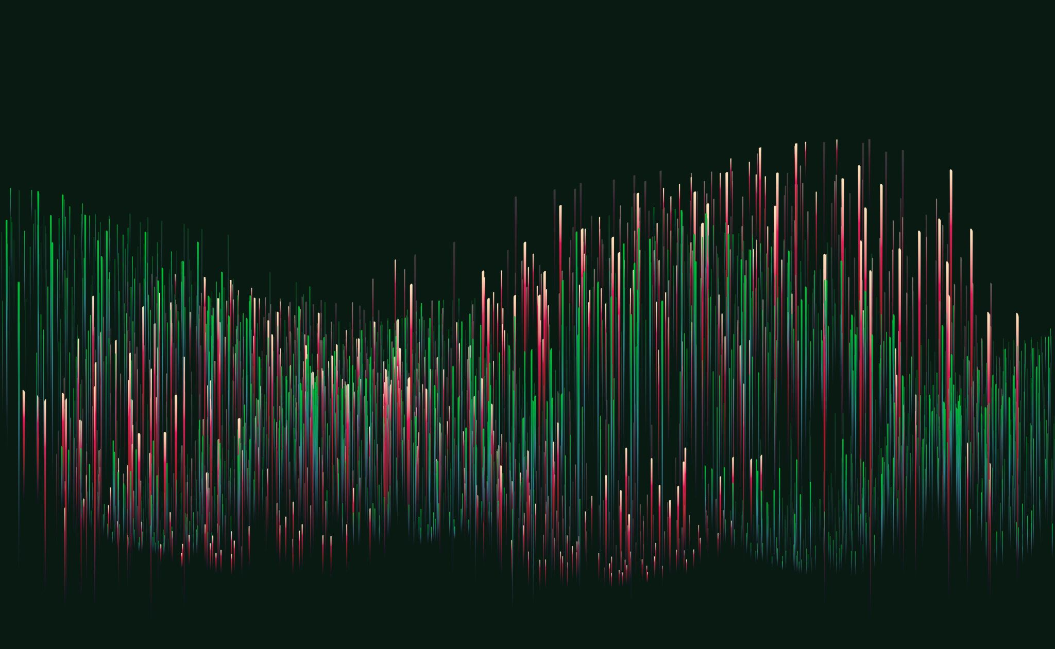
Communities analysis
Finding out how music clusters

Slide 9
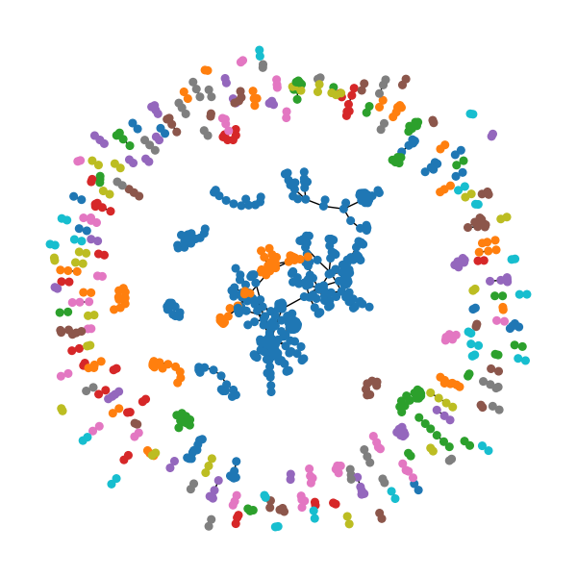
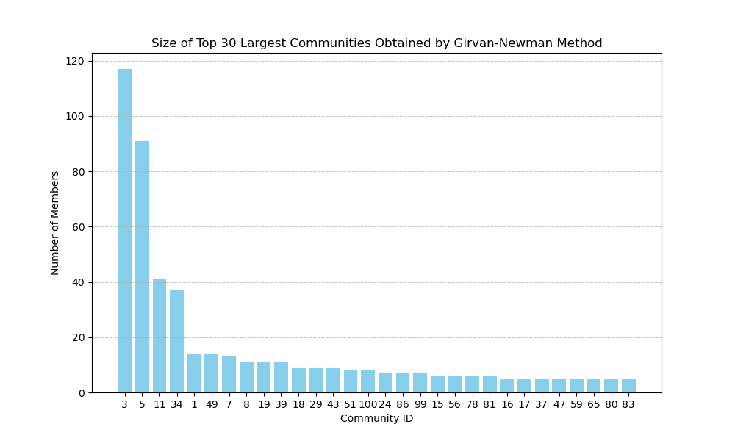
Communities analysis: Girvan-Newman methodology

Slide 10
Communities analysis: Girvan-Newman methodology
Community 3 diverse urban and pop scene
Community 5 electronic and alternative fusion
Community 11 fusion of indian sound
Community 34 vibrant latin music hub
Community 49 german dance and pop

Slide 11

Robustness and fault tolerance
What would happen to the music world in the case of an unexpected event?

Slide 12

What would happen to the music world in the case of an unexpected event?
Random failure
A group of various artists are taken hostage during a conference
Targeted attack
The world's most famous music artists are targeted and kidnapped at the same time for ransom

Slide 13
Random failure A group of various artists are taken hostage during a conference
Original network
After Random Failure
Size: 890
Clustering Coefficient: 0.014
Average Degree: 1.62
Giant Component Size: 208
Giant Component Clustering Coefficient: 0.015
Giant Component Avg Degree: 2.12
Giant Component Diameter: 16
Giant Component Avg Shortest Path Length: 7.26
Size: 846
Clustering Coefficient: 0.016
Average Degree: 1.53
Giant Component Size: 90
Giant Component Clustering Coefficient: 0.03
Giant Component Avg Degree: 2.2
Giant Component Diameter: 14
Giant Component Avg Shortest Path Length: 5.92

Slide 14
Random failure A group of various artists are taken hostage during a conference
Giant Component: the size of the giant component decreases to 95 artists, signaling a fragmentation of the network and a loss of connectivity among artists.
Giant Component Clustering Coefficient: Despite the decrease in size, the clustering coefficient of the giant component remains consistent, underscoring the persistence of collaboration within smaller clusters of artists.
Giant Component Average Shortest Path Length: The decrease in average shortest path length to 5.92 suggests that, while paths between artists may be shorter within the giant component, the overall network experiences increased fragmentation and isolation.

Slide 15
Targeted attack The world's most famous music artists are targeted and kidnapped at the same time for ransom
Original network
After Targeted Attack
Size: 890
Clustering Coefficient: 0.014
Average Degree: 1.62
Giant Component Size: 208
Giant Component Clustering Coefficient: 0.015
Giant Component Avg Degree: 2.12
Giant Component Diameter: 16
Giant Component Avg Shortest Path Length: 7.26
Size: 840
Clustering Coefficient: 0.007
Average Degree: 1.32
Giant Component Size: 42
Giant Component Clustering Coefficient: 0.027
Giant Component Avg Degree: 2.095
Giant Component Diameter: 10
Giant Component Avg Shortest Path Length: 4.27

Slide 16
Targeted attack The world's most famous music artists are targeted and kidnapped at the same time for ransom
Clustering Coefficient: The decrease in clustering coefficient to 0.007 signifies a disruption in collaboration patterns, as the removal of influential artists destabilizes local clusters within the network.
Average Degree: The decrease in average degree to 1.32 indicates a significant reduction in collaboration opportunities, with fewer connections between remaining artists.
Giant Component: The size of the giant component dwindles to 42 artists, highlighting the severe fragmentation and loss of connectivity within the network.
Giant Component Average Shortest Path Length: The decrease in average shortest path length to 4.27 reflects the increased fragmentation and isolation within the network, as artists struggle to navigate pathways between collaborators

Slide 17
Conclusions
Random failure scenario: Moderate impact, reduction in collaboration opportunities, and connectivity. Network experiences fragmentation and decrease in size, but cohesive clusters of collaboration persist.
Targeted attack on popular artists: Pronounced and concentrated disruption, significant loss of connectivity and collaboration opportunities. Heightened fragmentation and isolation among remaining artists.
Effects of targeted attack: Profound destabilization of collaboration patterns and navigation pathways throughout the network.
Conclusion: Emphasizes the critical role of influential nodes in sustaining network resilience. Highlights network susceptibility to targeted disruptions aimed at prominent figures.

Slide 18
Thank you
☺

